Slide 1
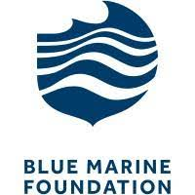
Blue Marine Foundation

Slide 2
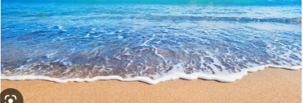
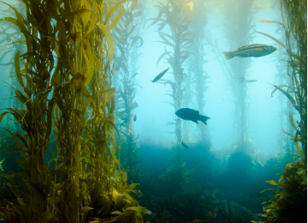
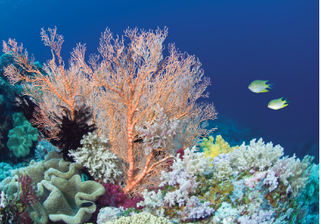
Why they are a good charity ?
This is a good charity because Blue Marine Foundation helps the earth’s climate as well as helping the ocean (trying to grow back the coral reefs and the sea grass meadows) https://www.bluemarinefoundation.com/projects/sussex-kelp/
They aim to stop over fishing which strips the ocean of life
They are putting oysters back in the sea to live freely
They are a charity dedicated to restoring the ocean

Slide 3

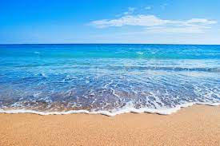
Things the Blue Marine Foundation did!!!
In 2010 to 2015 they created the largest marine protected area in the world
Around Chagos in the Indian ocean.
They closed a huge fishing area (around the area of France!)
There trying to put the ocean under protection.
There trying to spread the word about climate change
There trying to stop using electric fishing in Europe

Slide 4
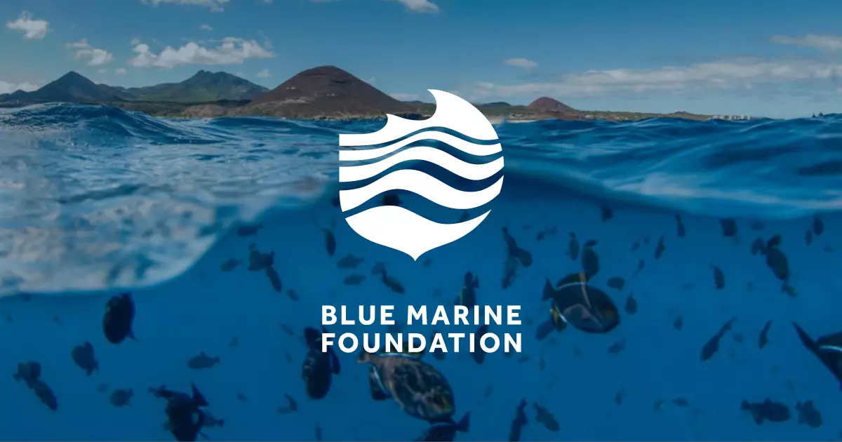
Thank you for watching my presentation!!!!
(I hope you enjoyed)

Slide 5
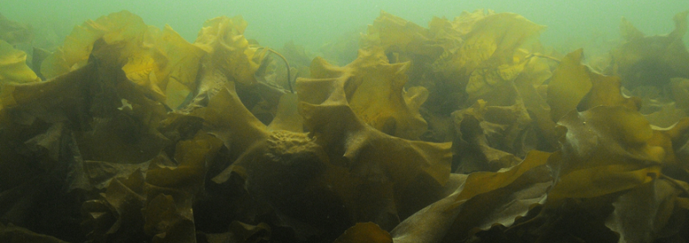
Do you know what sugar kelp is?
Sugar kelp is a common kelp seaweed found in shallow seas around our coasts. It grows attached to rocky seabeds using root-like holdfasts. It grows at depths up to 30m and are found mainly on sheltered shores, including in deep rockpools. Unlike other kelp seaweeds, Sugar kelp has one long ribbon like frond on a short thin stipe (like a stem). This long, wide frond is crinkled throughout and gives the seaweed its other name of Sea belt. The short stipe is very flexible so that it bends and keeps the frond submerged in shallow water to prevent it from drying out on low tides.
Find out more
https://www.suffolkwildlifetrust.org/wildlife-explorer/marine/seaweeds-and-seagrass

