Slide 1
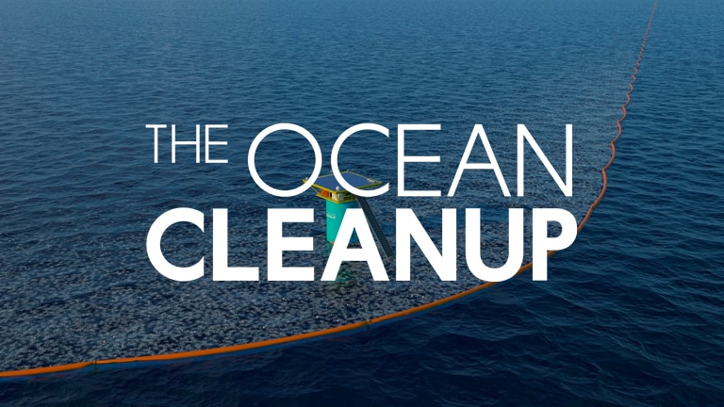

Slide 2
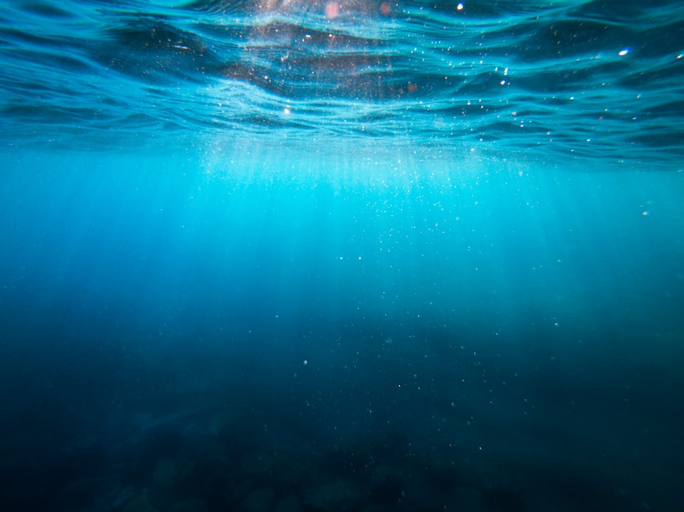
WHAT THEY DO
They aim to clean up 90% of floating ocean plastic
They have developed machines that can catch large amounts of rubbish
Loads of people are taking part to help
They are working every day to clean up the oceans

Slide 3
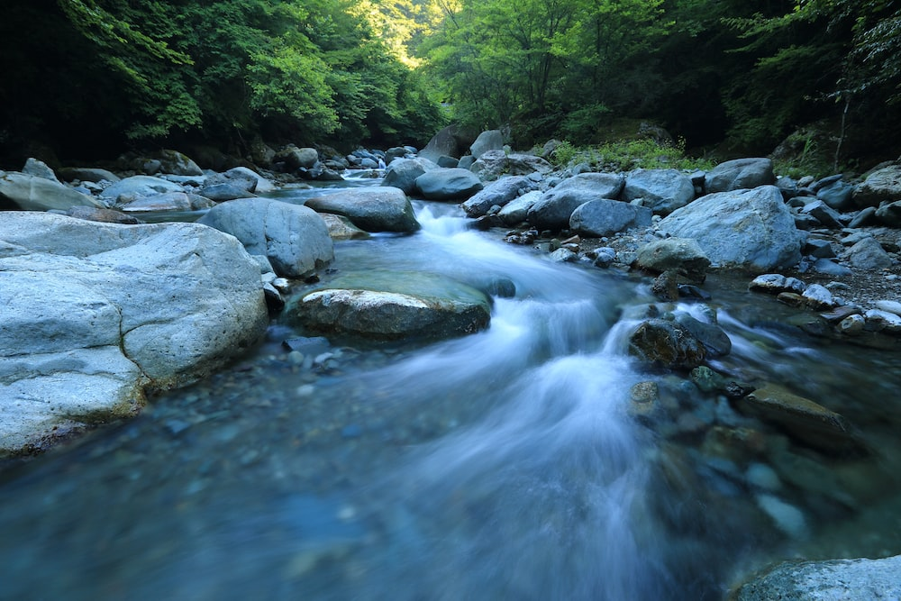
River clean up
They are also working to clean up rivers
They work in many large citys to stop rubbish getting into the sea
There involving many people to help clean our rivers

Slide 4
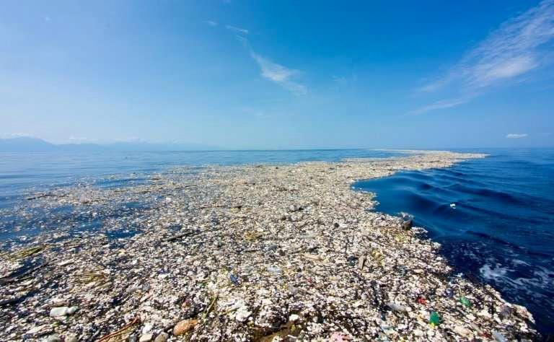
Rubbish patches and what they did with the rubbish
They turn the rubbish into new products
Once the plastic is in the ocean , it decomposes very slowly breaking into tiny pieces known as microplasticts .That can affect the food chain and become very damaging to the food chain.
Rubbish patches go to the Great Pacific Garbage Patch where they are turned into useful things.
A large amount of plastic , about eight million metric tons every year , ends up in the ocean.

Slide 5

Thank you for listening to our presentation we hope you enjoyed!

